Slide 1
COMP1860 Building our Digital World: Computer Systems & Architecture
S1.W8.L2: Memory
Leandro Soares Indrusiak

Slide 2


Slide 3
Last time
We learnt how to design and implement Finite Sate Machines using a combination of combinational and sequential logic circuits
Today we will look at how to build memory blocks using both combinational and sequential logic circuits.

Slide 4
Objectives
Understand the building blocks of computer memory
Understand the memory hierarchy
Understand the different types of memory and their properties
Implement the circuits (CHIPS) required to for our HACK Computer Memory.

Slide 5
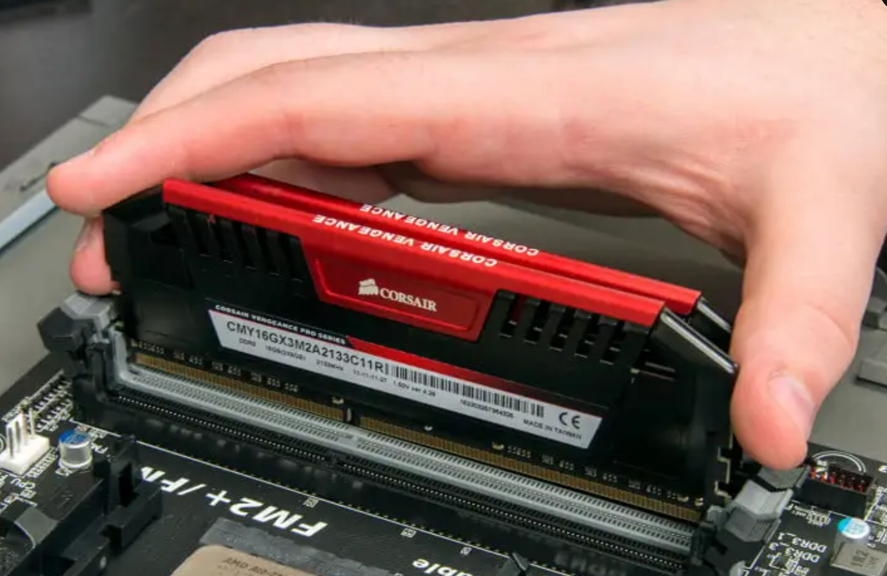
Main memory on PC

Slide 6
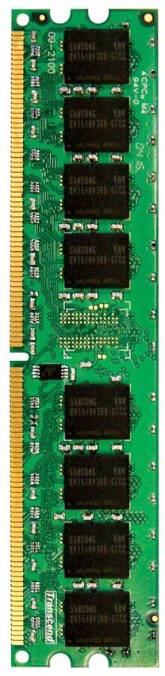
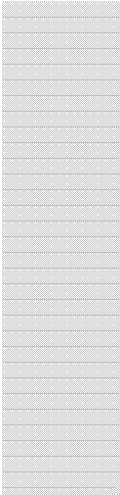






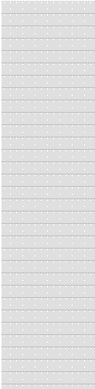
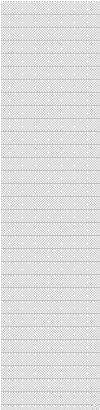


Main Memory in the System
L2 CACHE 0
L2 CACHE 1
SHARED L3 CACHE
DRAM INTERFACE
CORE 0
CORE 1
DRAM BANKS
DRAM MEMORY CONTROLLER
L2 CACHE 2
L2 CACHE 3
CORE 2
CORE 3

Slide 7
Key Characteristics
The design of a computer’s memory is constrained by capacity, transfer rate and cost.
In general:
faster access time requires greater cost per bit;
greater capacity implies smaller cost per bit;
greater capacity implies slower access time.

Slide 8
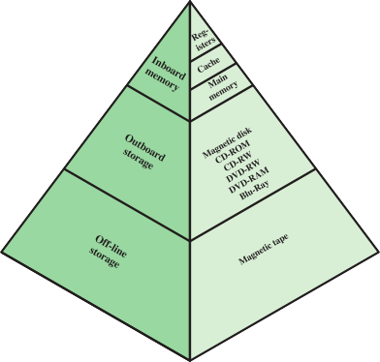
Location
The location of the memory refers to where it is in relation to the computer.
The CPU has its own local memory in registers.
Internal memory (or main memory) resides within the computer.
External memory consists of peripheral storage devices.
This leads to a memory hierarchy.

Slide 9
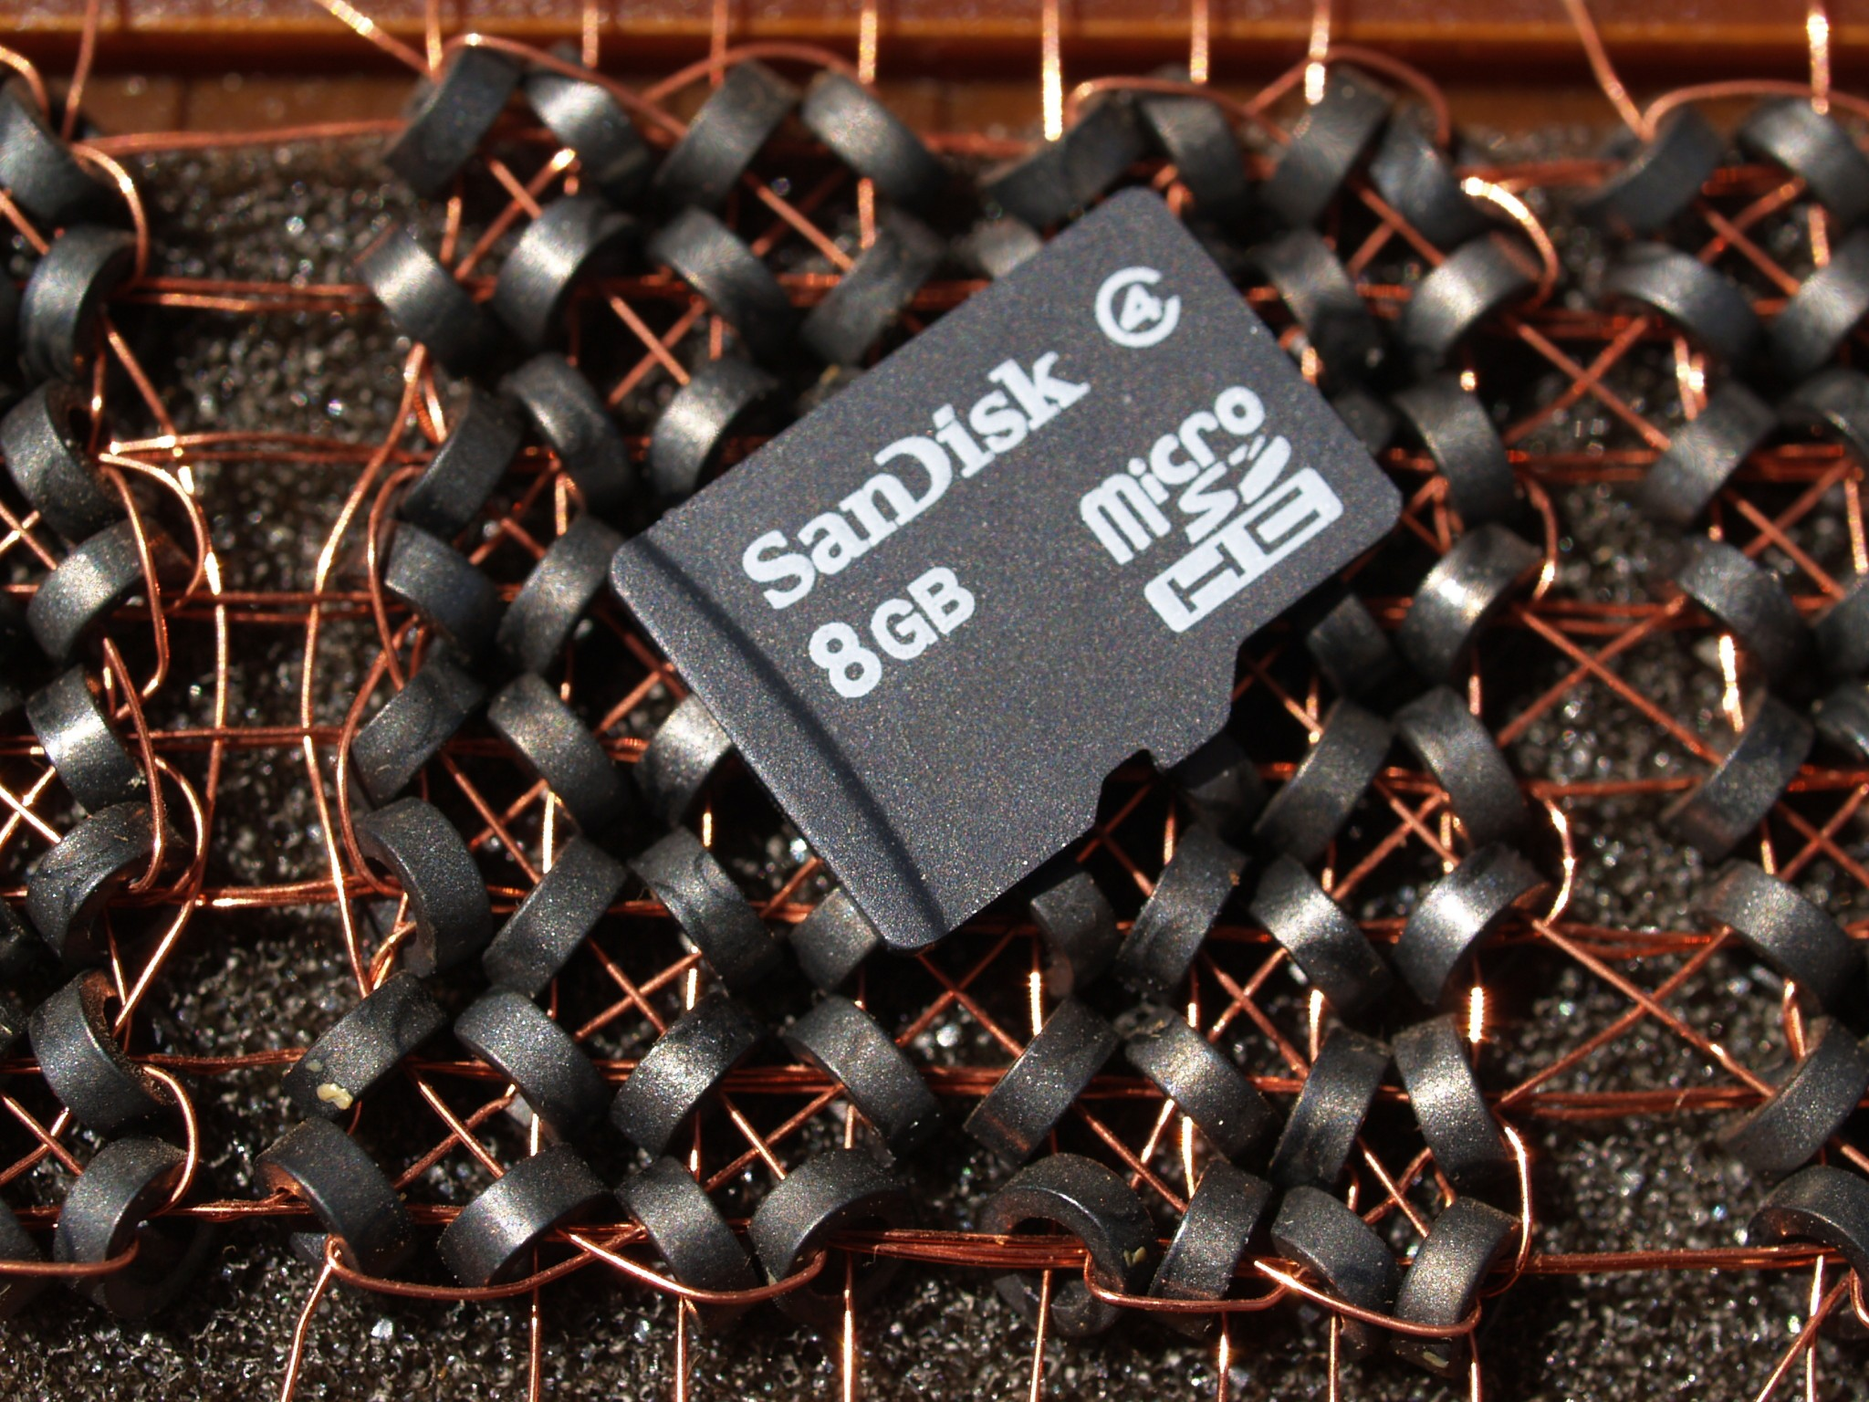
Capacity
The capacity of the memory is the number of bytes (or preferably words) it can store.
The word size (or length) is the natural unit of organisation.
It is usually equal to the number of bits used to represent an integer and to the instruction length.

Slide 10
Performance
There are three main performance parameters.
Access time (or latency) is the time between presenting the address and receiving or storing the valid data.
  Time may be required for the memory to “recover” before the next access.
Memory cycle time is the access time plus the recovery time.
  Address setup: Setting up the memory address for the desired data location
  Data access:
  Precharge and refresh: Resetting or refreshing the memory cells for future use.
Transfer rate is the rate at which data can be moved.
  E.g., Mbytes / second

Slide 11
The unit of transfer is the number of data lines into and out of the memory module.
For internal memory this is usually governed by the data bus width.
For external memory this is often a block much larger than a word.
The addressable unit is the smallest location which can be uniquely addressed.
  This is often a word, but can be a byte.

Slide 12
Access Method
Sequential access starts at the beginning of the memory and accesses records in order.
Access time depends on the location of the data and the previous location.
This is highly variable.
Direct access moves to a general region of memory then uses sequential access.
Individual blocks have unique addresses.
Access time still depends on location and previous location.

Slide 13
Access Method
Random access allows any selected memory location to be directly addressed and accessed.
Unique physical addresses identify locations exactly.
Access time is independent of location or previous access.

Slide 14
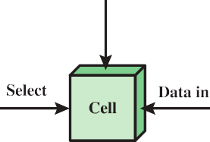
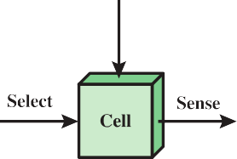
Semiconductor memory
Semiconductor memory is based on memory cells which:
exhibit two stable states, nominally 1 and 0;
can be written into to set the state;
can be read to sense the state.
This includes RAM, ROM and Flash memory.
1

Slide 15
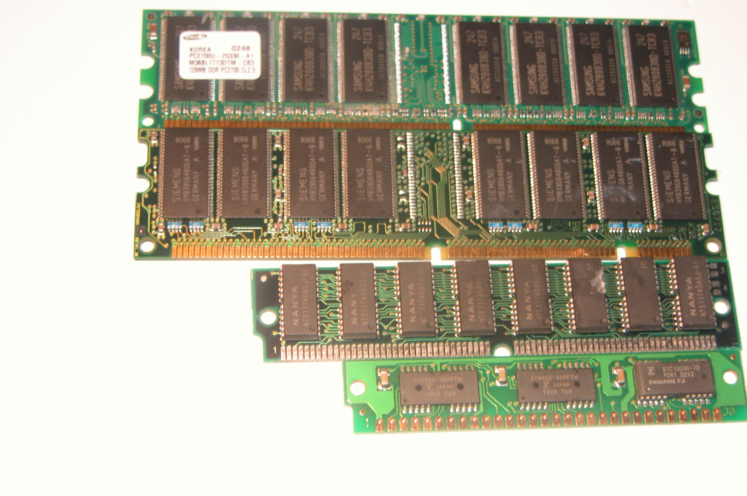
RAM (random access memory) is actually misnamed since semiconductor memory is always random access.
RAM
It is really read/write memory.
It is volatile and so only useful for temporary storage.

Slide 16
Types of RAM
For dynamic RAM:
cells store bits as charge in capacitors;
charge can leak so the cells need to be periodically refreshed, even when powered (hence dynamic).
For static RAM:
cells store bits using the same on/off logic elements used in the processor;
there are no charges to leak, so no refreshing is needed when powered.

Slide 17
Types of RAM
DRAM is simpler and smaller, so it provides denser storage and is less expensive.
  It is favoured for large memory requirements,
e.g. main memory.
SRAM requires less circuitry (for refreshing) and is faster.
  It is favoured for cache memory.

Slide 18
Refreshing
All DRAM requires a refresh operation.
A refresh circuit is included on the chip.
It disables the chip while refreshing.
It loops through the rows, reading and then writing back the contents of each cell.
The apparent performance is reduced.

Slide 19
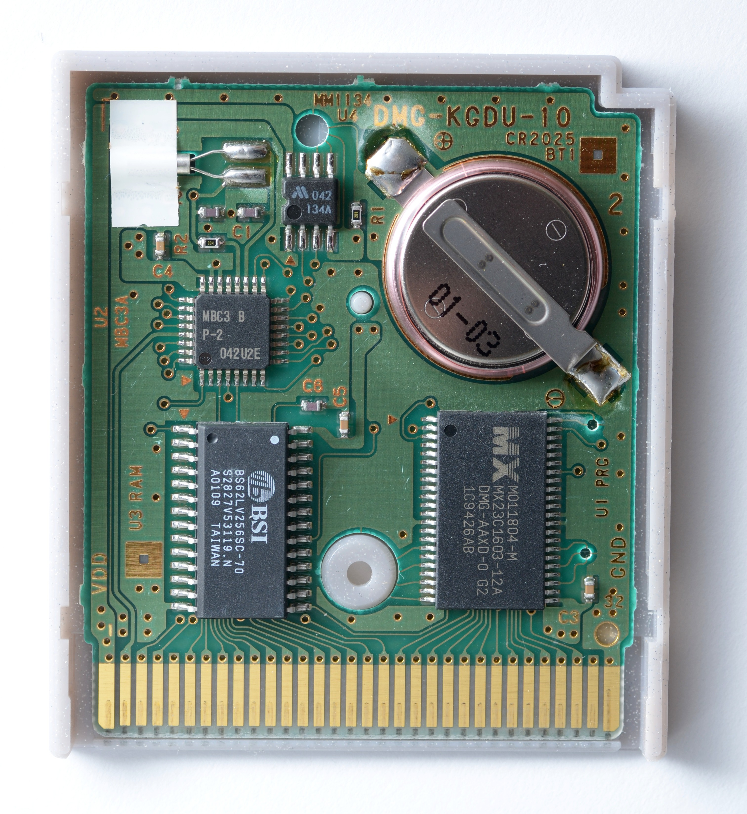
ROM (read-only memory) provides permanent data storage which cannot be changed.
ROM
It is nonvolatile, requiring no power source to maintain it.
This means that data can be “wired in” during manufacture, e.g., library subroutines, systems programs.
This makes it expensive for small manufacturing runs.
The inside of a a Pokémon Silver Game Boy cartridge

Slide 20
Discussion
Your turn
How do the design constraints of a desktop PC and mobile phone influence the choice of memory design?

Slide 21
Registers (Reminder)
A register is a collection of bits
The width of a register is dependent on the architecture
  Our architecture is 16-bit
Share a common load control bit

Slide 22
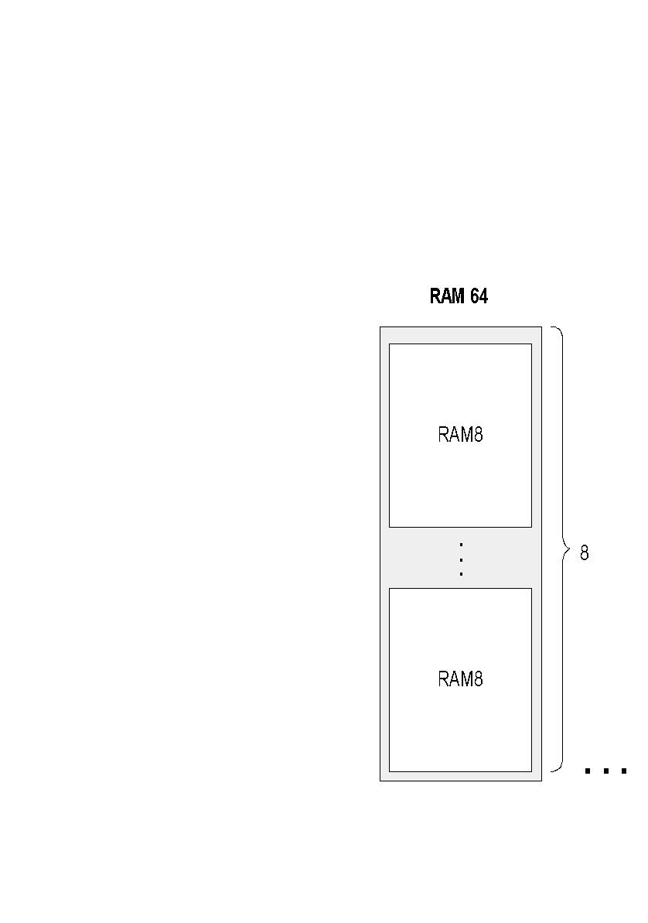
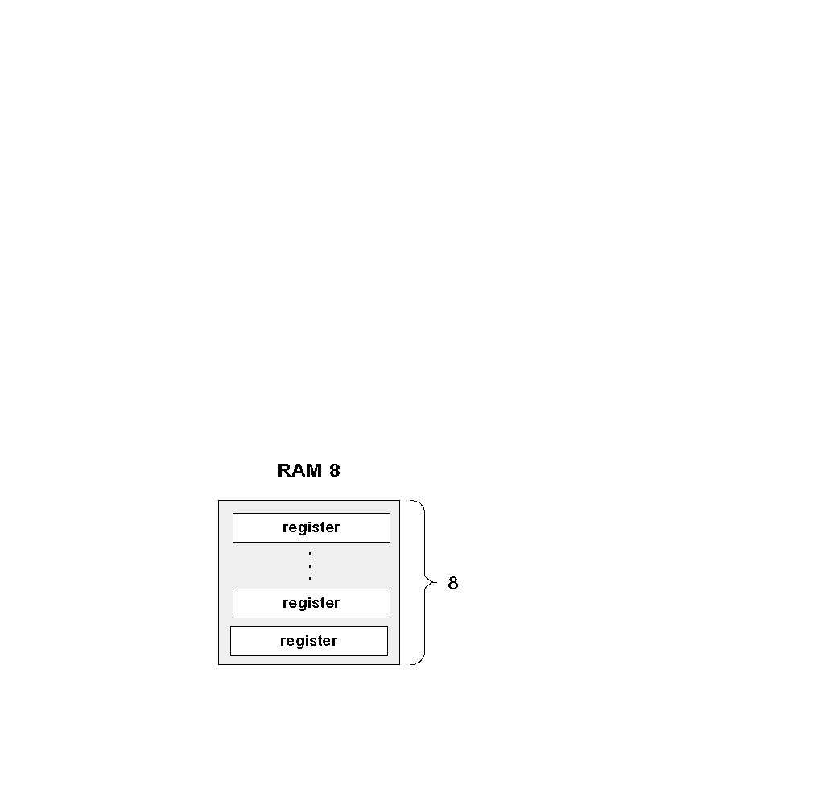
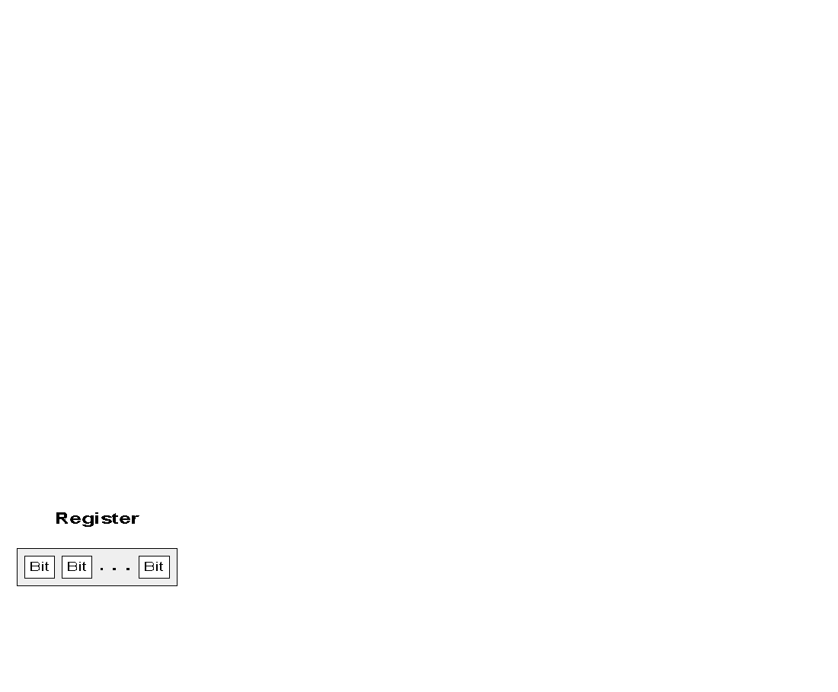
Random Access Memory
Recursive ascent

Slide 23
Random Access Memory
With an n-bit address 2^{n} locations can be addressed
RAM8 - constructed from 8 registers
RAM64 - constructed from 8 RAM8’s
RAM512 - constructed from 8 RAM64’s
RAM4k - constructed from 8 RAM512’s
So on...

Slide 24
Random Access Memory
Random Access Memory (RAM) is a type of memory where access to arbitrary positions is possible at uniform cost
Memory locations are numbered from 0 to n often where n is a power of 2

Slide 25
RAM: Abstraction
RAM of n registers:
Usage:
To read register i :
set address = i,
probe out
(out always emits the state of RAM[i])
To write v in register i :
set address = i,
set in = v,
set load = 1
Result: RAM[i] ← v
From the next time-step onward, out emits v

Slide 26
RAM: Implementation
RAM of n registers:
Partial diagram, showing some of the chip-parts, without connections
load
in
out
Register
w
w
in
w
load
in
out
Register
out
load
w
w
w
address
...
load
k
in
out
Register
w
w

Slide 27
RAM: Implementation
RAM of n registers:
Partial diagram, showing some of the chip-parts, without connections
load
in
out
Register
w
w
in
w
load
in
out
Register
out
load
w
w
Mux
(n to 1)
w
address
...
load
k
in
out
Register
w
w
Reading: Can be realized using a Mux

Slide 28
RAM: Implementation
RAM of n registers:
Partial diagram, showing some of the chip-parts, without connections
load
in
out
Register
w
w
in
w
load
in
out
Register
out
load
DMux
(1 to n)
w
w
Mux
(n to 1)
w
address
...
load
k
in
out
Register
w
w
Reading: Can be realized using a Mux
Writing: Can be realized using a DMux

Slide 29
Your turn: How are these components connected to the registers?

Slide 30
RAM: Implementation
RAM of n registers:
Partial diagram, showing some of the chip-parts, without connections
load
in
out
Register
w
w
in
w
load
in
out
Register
out
load
DMux
(1 to n)
w
w
Mux
(n to 1)
w
address
...
load
k
in
out
Register
w
w
Observations
The addressing/selection/reading logic is combinational
The writing logic is (i) sequential (clocked)
(ii) embedded in the Register logic.

Slide 31
Hack RAM
load
A family of 16-bit RAM chips:
RAMn
chip name | n | k
RAM8 | 8 | 3
RAM64 | 64 | 6
RAM512 | 512 | 9
RAM4K | 4096 | 12
RAM16K | 16384 | 14
in
0
Register
16
1
Register
out
address
16
k
...
n-1
Register
Why these particular RAM chips?
Because that’s what we need for building the Hack computer.

Slide 32
8-Register RAM: Abstraction
load
RAM8.hdl
/*
Let M stand for the state of the register
selected by address.
if load(t – 1) then {M = in(t), out(t) = M}
else out(t) = M
*/
CHIP RAM8 {
IN in[16], load, address[3];
OUT out[16];
PARTS:
// Put your code here:
}
RAMn
in
Register
16
Register
out
address
16
3
...
Register

Slide 33
8-Register RAM: Implementation
load
in
out
Register
16
16
in
16
load
in
out
Register
out
load
DMux
(1 to 8)
16
16
Mux
(8 to 1)
16
address
...
load
3
in
out
Register
16
16
Partial diagram, showing some of the chip-parts, without connections
Implementation tip:
Follow the chip diagram

Slide 34
n-Register RAM
load
chip name | n | k
RAM8 | 8 | 3
RAM64 | 64 | 6
RAM512 | 512 | 9
RAM4K | 4096 | 12
RAM16K | 16384 | 14
RAMn
in
Register
16
Register
out
address
16
k
...
Register
Implementation tips
Think about the RAM’s address input
as consisting of two fields:
  One field selects a RAM-part;
  The other field selects a register within that RAM-part
Use logic gates to effect this addressing scheme.

Slide 35
n-Register RAM
load
RAMn.hdl
/*
Let M stand for the state of the register
selected by address.
if load(t – 1) then {M = in(t), out(t) = M}
else out(t) = M
*/
CHIP RAMn {
IN in[16], load, address[k];
OUT out[16];
PARTS:
// Put your code here:
}
RAMn
in
Register
16
Register
out
address
16
k
...
Register

Slide 36

Your Turn
Given
All the chips built in projects 1 and 2
Data Flip-Flop (built-in DFF gate)
Build the following chips
Bit
Register
PC
RAM8
RAM64
RAM512
RAM4K
RAM16K
A family of RAM chips

Slide 37
Summary
The building blocks of computer memory
Memory hierarchy
Implemented the circuits (CHIPS) required to for our HACK Computer Memory.

